Slide 1

Sprint 1 Review
Kineo Learning Analytics
17 April 2025

Slide 2
Agenda
Sprint 1 goals
Sprint 1 status overview
Demos
Databricks
Power BI
Natural Language Q&A
Sprint feedback
Sprint statistics
Sprint 2 discussion

Slide 3
Sprint 1 goals
Goals:
POC for Learning Platform Course Completion dashboard
POC for natural language Q&A
Idea: thinnest vertical end-to-end slice of analytics platform
Functional data pipeline → support for multiple frontends
Prove viability + research through implementation

Slide 4
Sprint 1
Datasets
Learning Platform Course completion
Learning Platform other datasets
Learning Platform Learnforce
Learning Content Course completion
Data sourcing and integration
SFTP
REST API
Data cleaning and standardization
Validation
Standardization
Alerts & Monitoring
Data transformation and storage
Parity transformation
Data segregation by company
Cross-course content aggregation
Data access
API
Row-level security
SSO
Visualization & Insights
Parity dashboard
New dashboard
Chat Q&A (web)
Power BI integration
Predictive AI
Advanced analytics
Learning pathway
Export to common formats
Department-specific views
Chat Q&A (MS Teams)
Customizable dashboard
AI insight generation
Interactive storytelling
Skills journey
Infrastructure and automation
Scaling and performance
Infra-as-code deployment
CI/CD pipeline
Administration
Who administers customers and how?
How can Service desk debug and support clients?

Slide 5
Sprint 1 status overview
Functional data pipeline (data manually uploaded)
Functional Power BI dashboard (not embedded)
Functional natural language Q&A

Slide 6
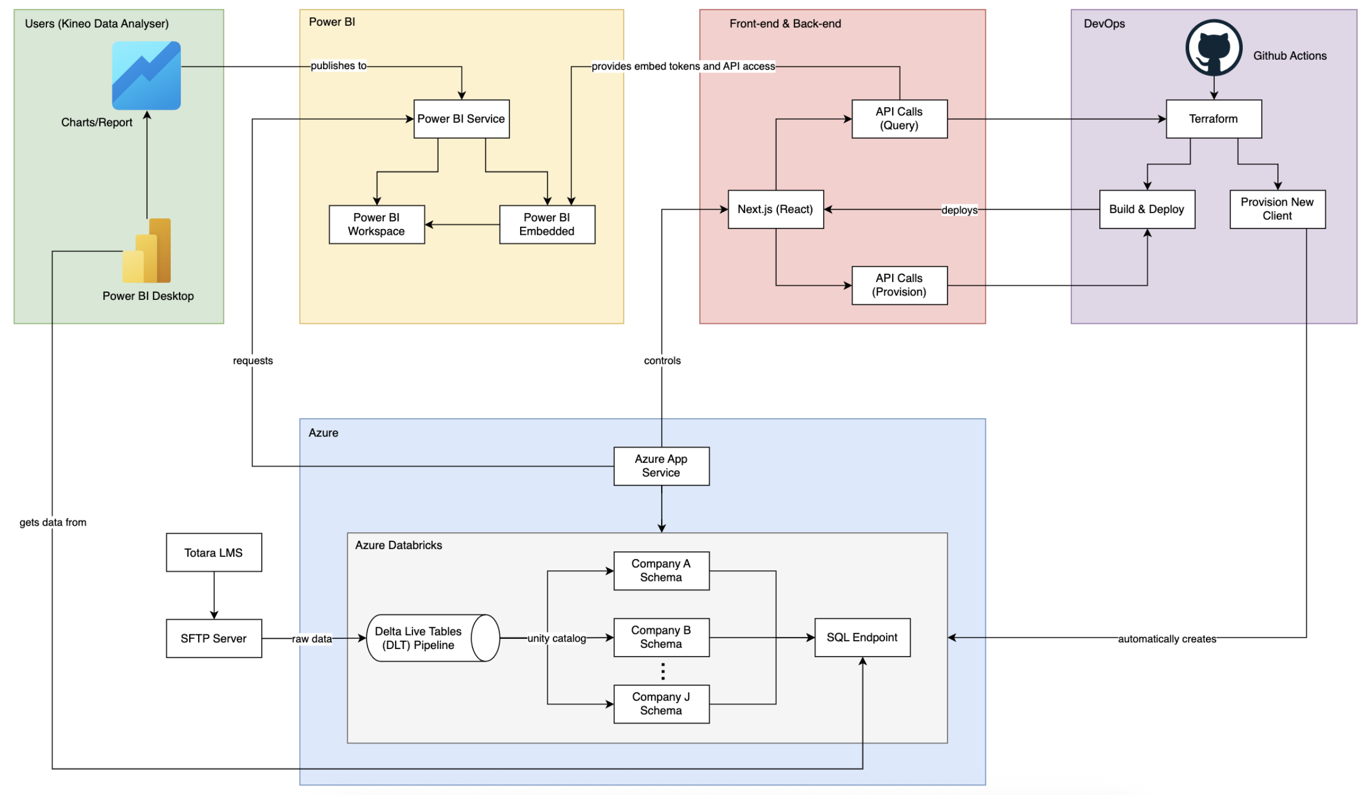
System Architecture

Slide 7
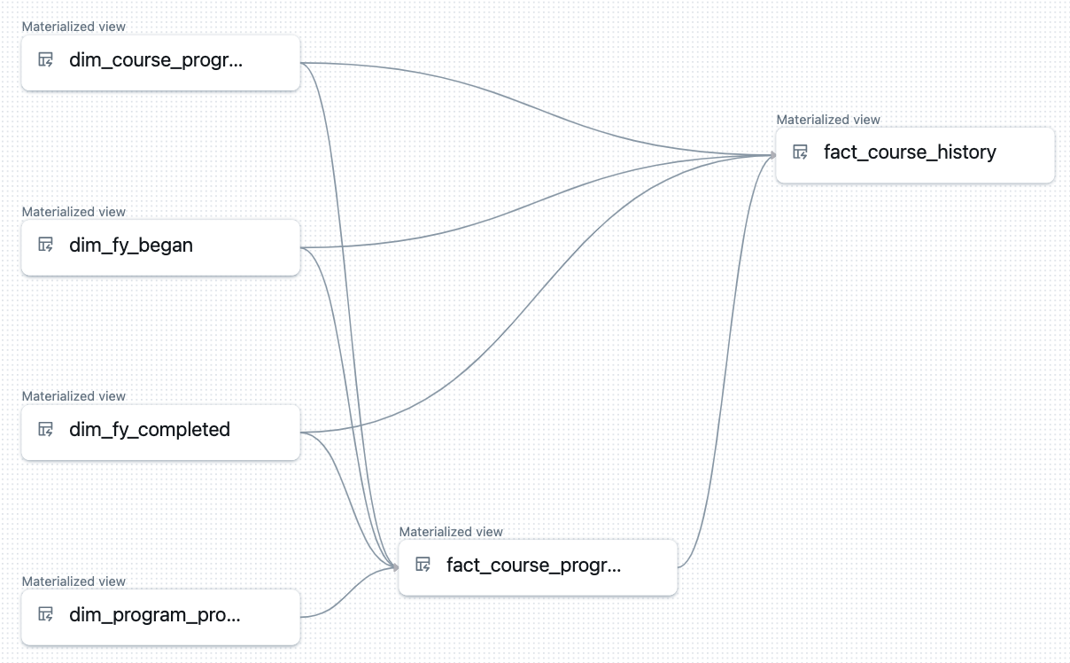
Demo - Databricks
Raw Data
(.csv file)
Null data handling
Data format conversion
(using PySpark)
Cleaned Data
Written to Delta Lake
Stored in a managed schema
(using Spark SQL)
Delta Table

Slide 8
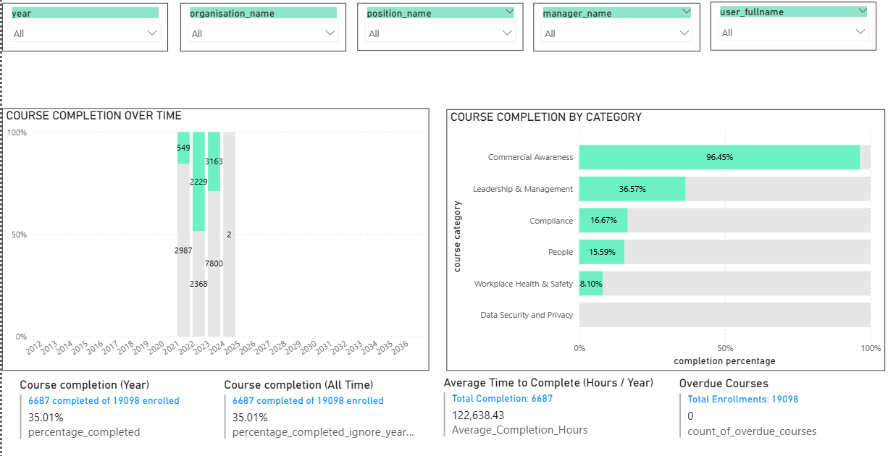
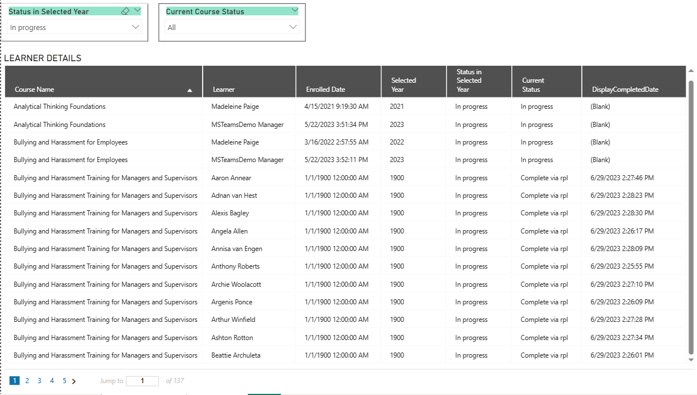
Demo – Power BI
Course Completion Dashboard in Power BI Desktop:
Course Completions over Time chart
Course Completions by Category chart
Secondary Metrics
Course Completion (Year)
Course Completion (All Time)
Average Time to Complete
Overdue Courses
Learner Details table

Slide 9
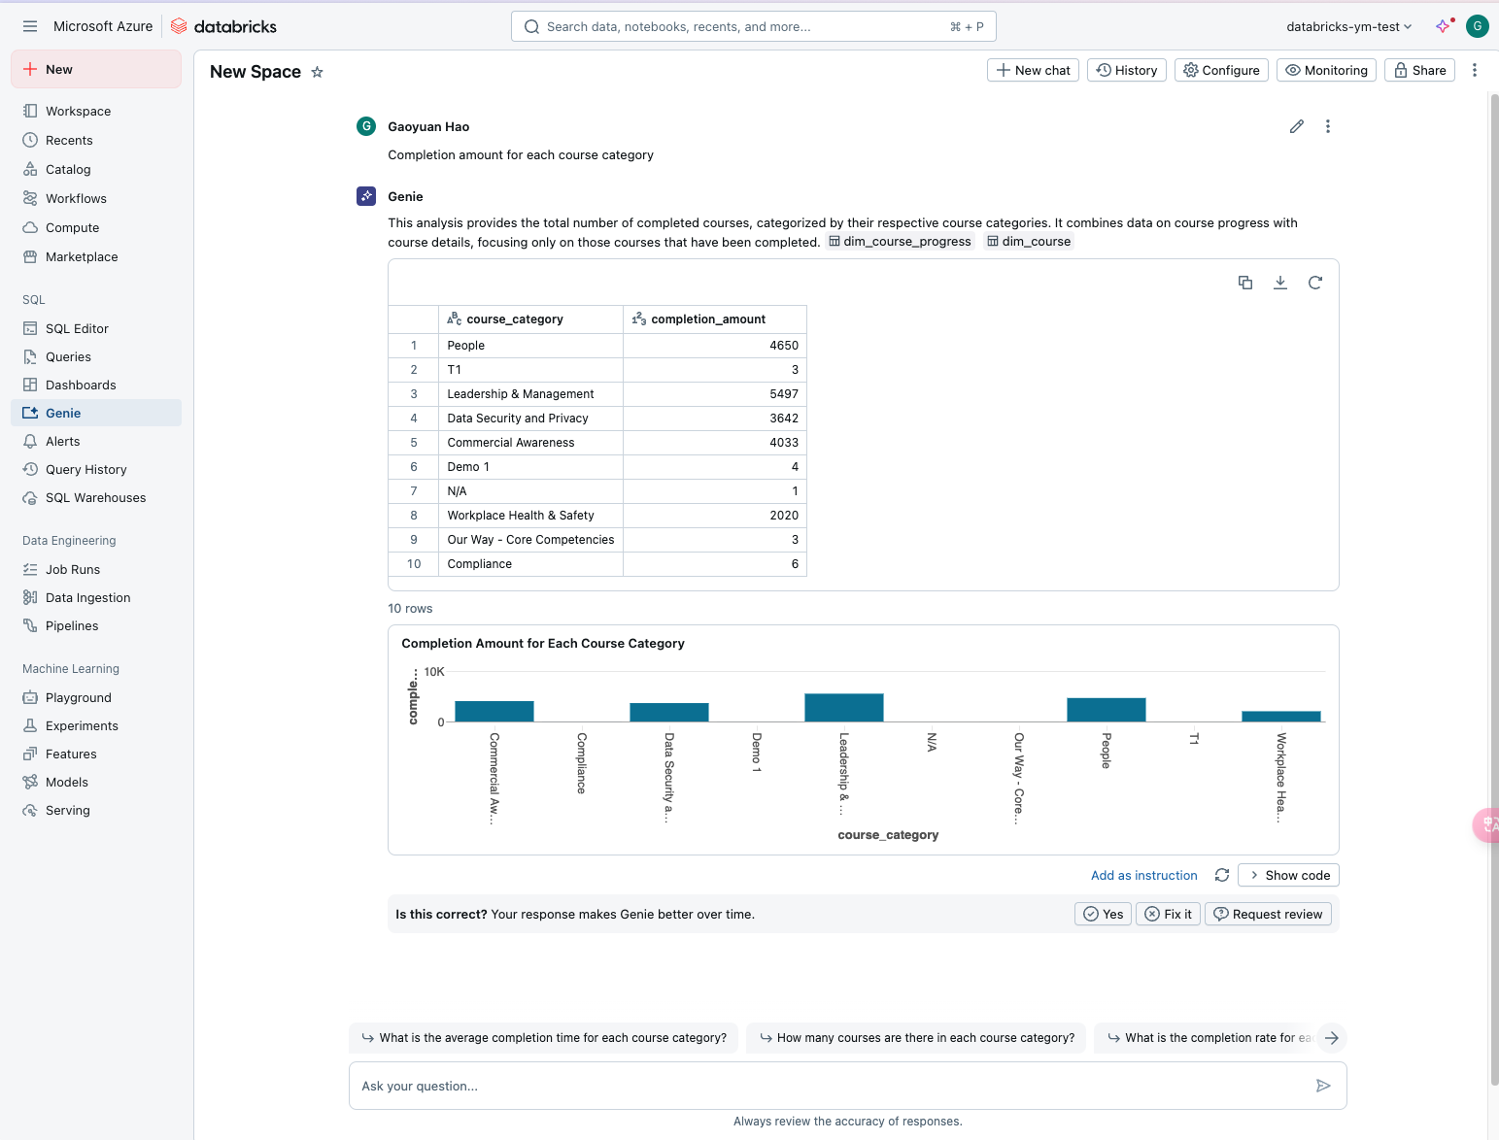
Demo – Natural Language Q&A
Using Genie in Databrick to query data.
In the future, we can integrate it while
Restful Api
Its fee is included in Dataware house

Slide 10

Sprint feedback
Feedback from client
Choice of technology and cost

Slide 11

Databricks cost
3 cost components:
All-purpose compute: interactive data analysis (run notebooks)
Job compute: ingestion, transformation etc.
SQL warehouse: run queries and return data to frontend
Each component consumes DBU and VM units
Total cost = Hour per component * (#DBU + #VM)
Auto stop after X period of inactivity
Estimated monthly cost (24 hours daily)
423 + 368 + 1590 = USD2381
Lowest tier
https://azure.microsoft.com/en-gb/pricing/calculator/

Slide 12
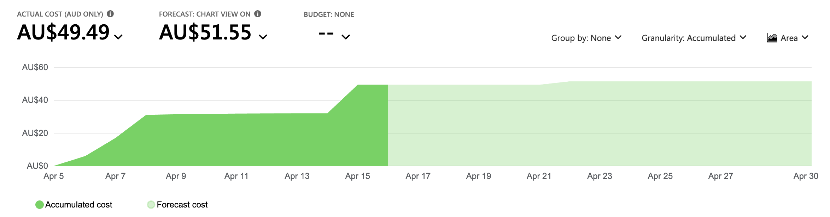
Databricks cost (charges so far)

Slide 13
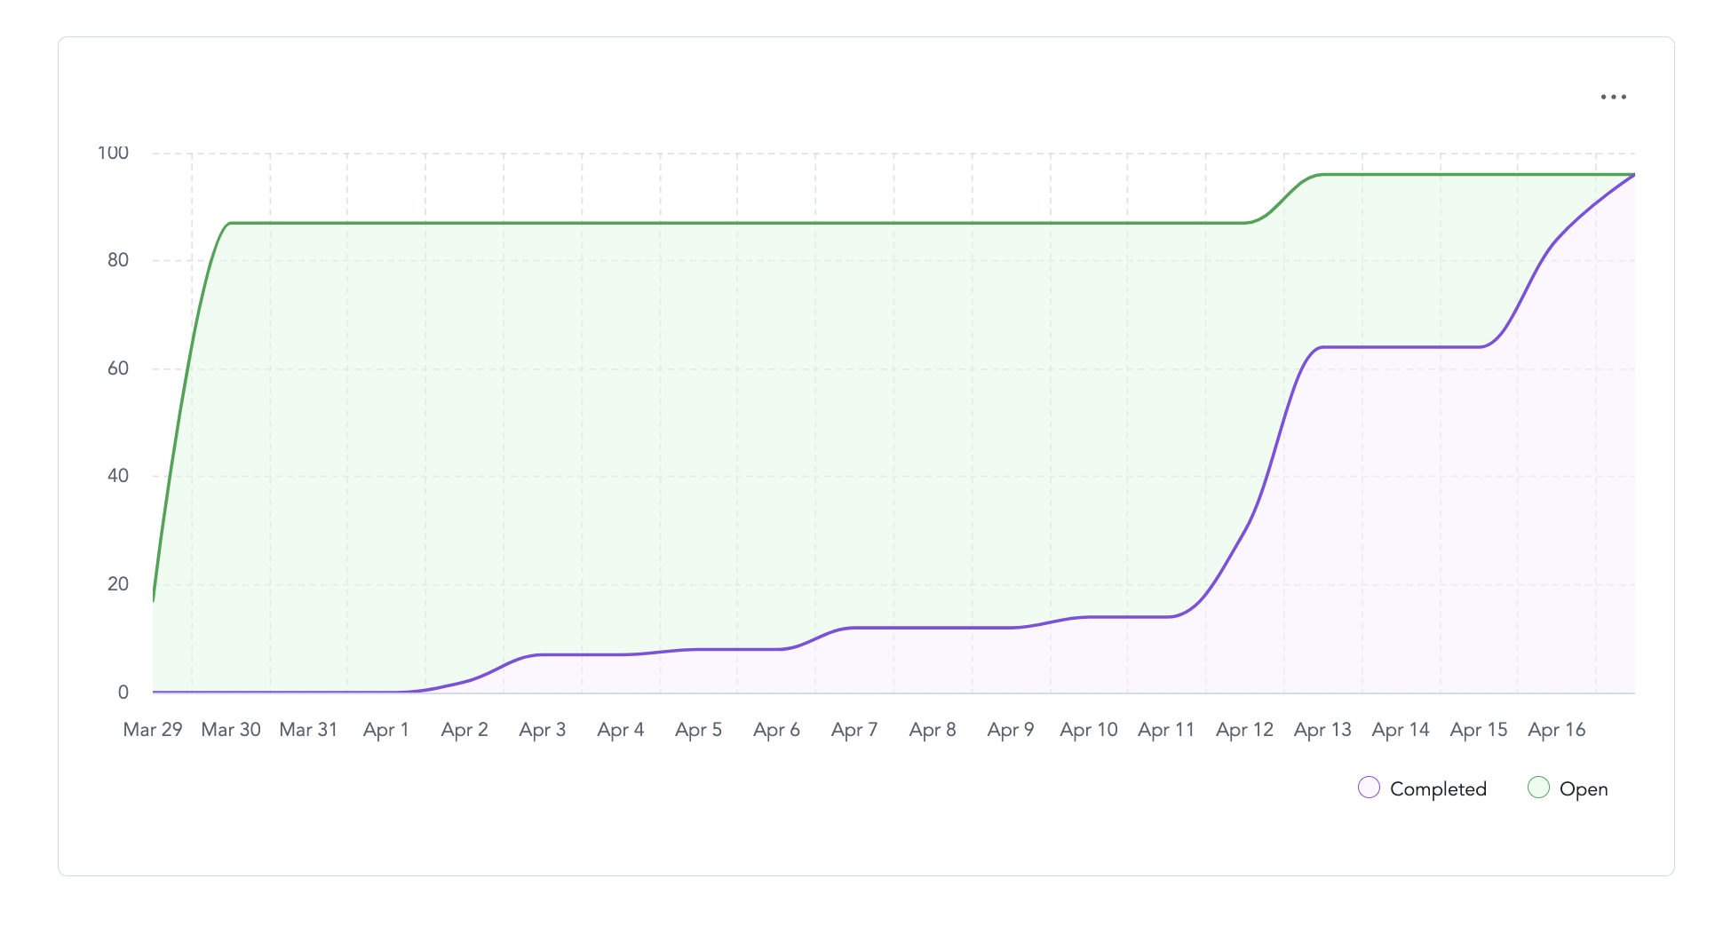
Sprint statistics
Burn up chart

Slide 14
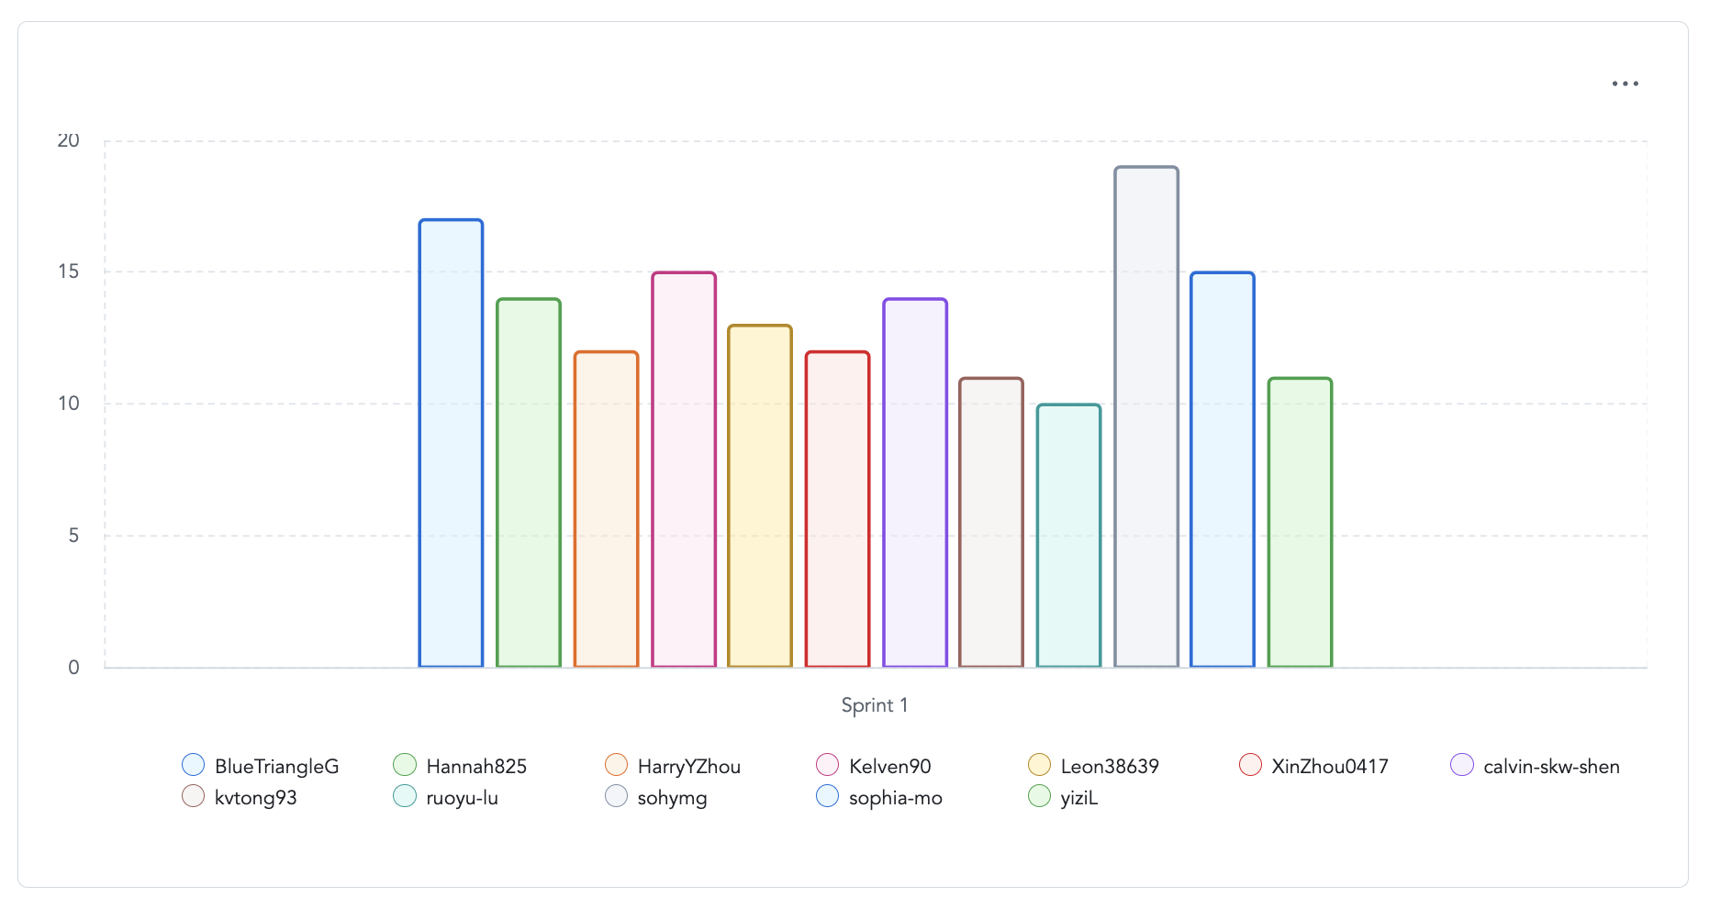
Sprint statistics
Teams capacity per sprint

Slide 15

Sprint 2 discussions

Slide 16
Timeline
Sprint 1
Sprint 2
Sprint 3
Sprint 4
Week 5
Week 6
Week 7
Term break
Week 8
Week 9
Week 10
Week 11
Week 12
End of semester 1
Today

Slide 17
Sprint 1
Sprint 2
Datasets
Learning Platform Course completion
Learning Platform other datasets
Learning Platform Learnforce
Learning Content Course completion
Data sourcing and integration
SFTP
REST API
Data cleaning and standardization
Validation
Standardization
Alerts & Monitoring
Data transformation and storage
Parity transformation
Data segregation by company
Cross-course content aggregation
Data access
API
Row-level security
SSO
Visualization & Insights
Parity dashboard
New dashboard
Chat Q&A (web)
Power BI integration
Predictive AI
Advanced analytics
Learning pathway
Export to common formats
Department-specific views
Chat Q&A (MS Teams)
Customizable dashboard
AI insight generation
Interactive storytelling
Skills journey
Infrastructure and automation
Scaling and performance
Infra-as-code deployment
CI/CD pipeline
Administration
Who administers customers and how?
How can Service desk debug and support clients?

